Slide 1
Holberton Hijinks
Kirby Yu, Helena Hald, and Leny Pan

Slide 2
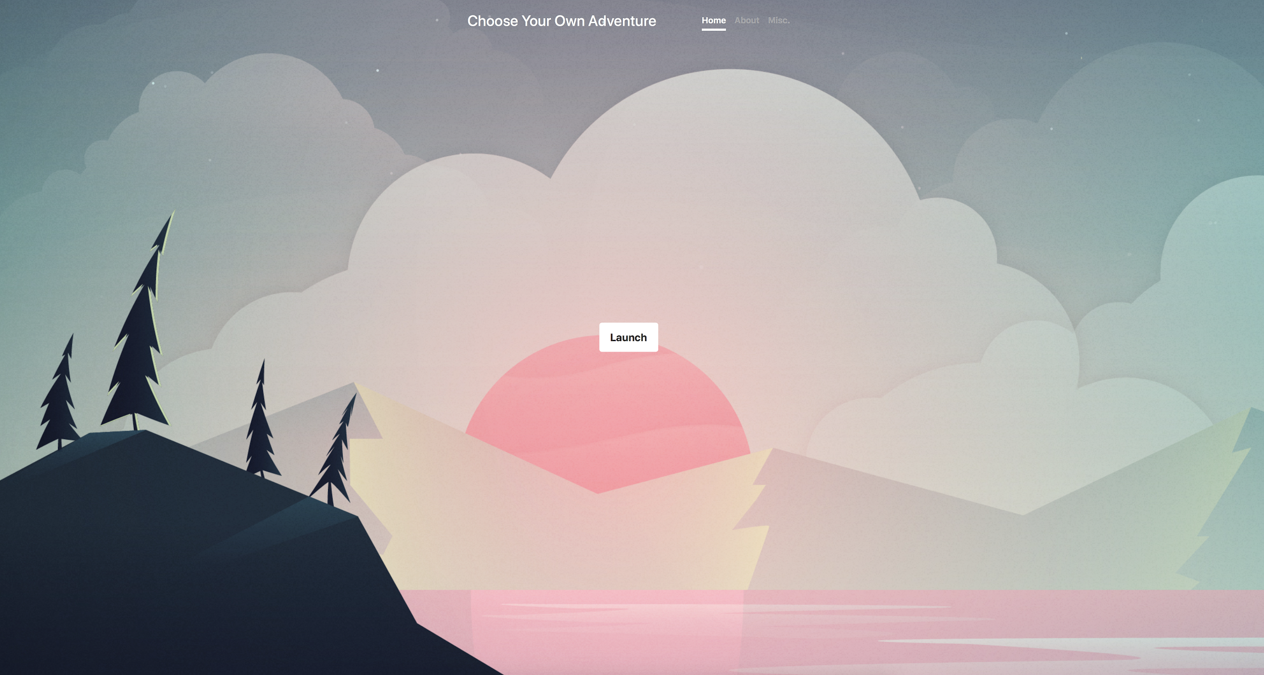
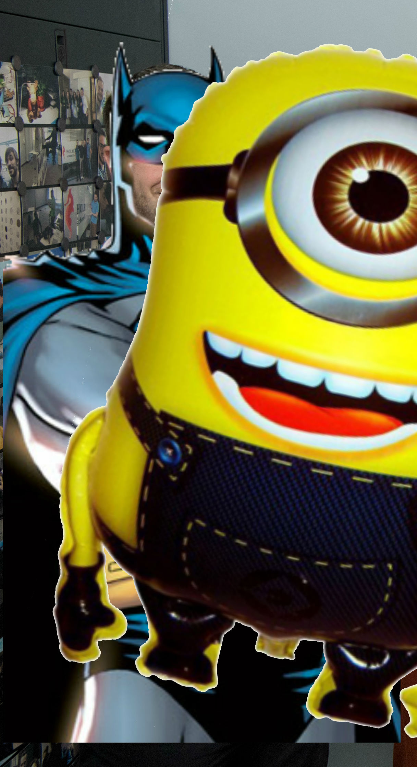

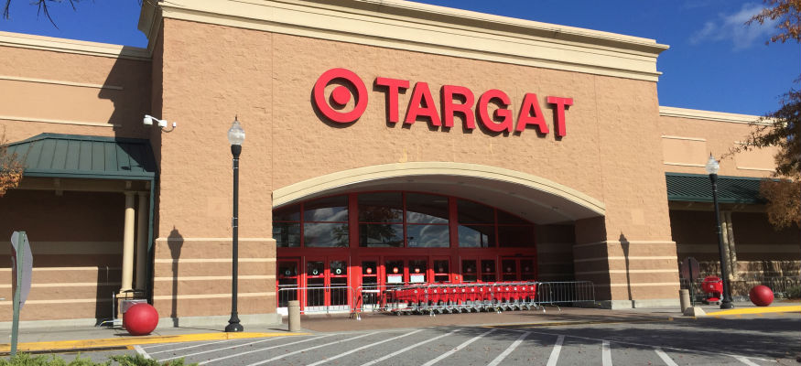
Holberton Hijinks -- a local all-organic non-GMO Create Your Own Adventure website

Slide 3
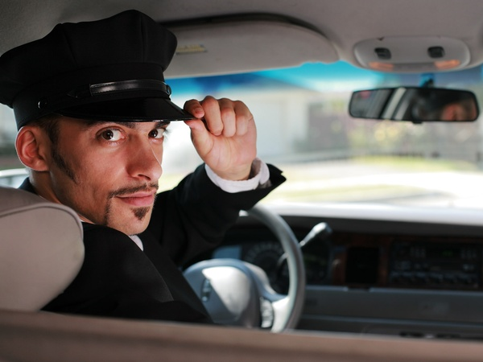
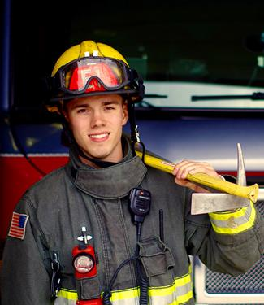

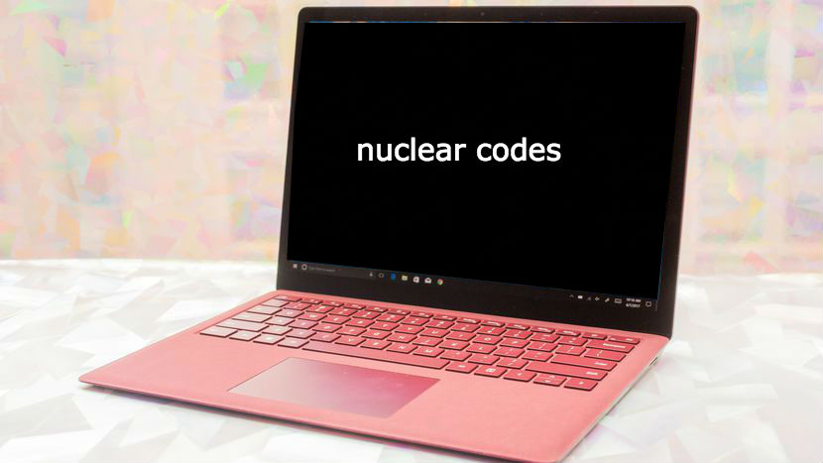
A story of Drama, Danger, and Devotion.

Slide 4
The Learning Experience
While working on this project, we learned how:
to efficiently link to pages within the site and use locally stored images.
to collaborate on a Github repository
to use a bootstrap template
Why more people don’t make choose-your-own-adventures

Slide 5
The Struggling Experience
Semicolons and quotation marks
Keeping track of files
Many github conflicts

Slide 6
Page layout -- homepage
Home, About, and Misc. tabs

Slide 7
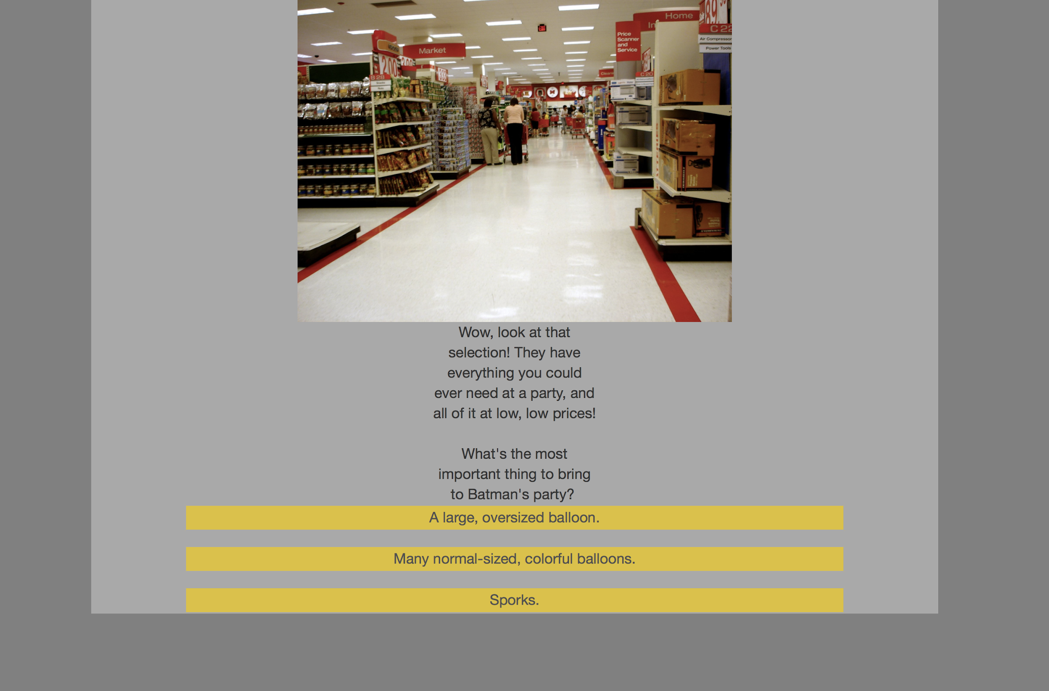
Page layout
HTML text and image placement
Javascript button links
CSS styling
Centered elements and div styling
100+ pages

Slide 8
Future additions
More functions, like minigames or something with javascript
A directory menu with all the paths listed in a tree
A more sophisticated design so that all the pages could have more pizazz, as we started with a rather plain design and it was a lot of work to replace it on every page.

